Slide 1
Disclaimer
These slides are intended as presentation aids for the lecture. They contain information that would otherwise be to difficult or time-consuming to reproduce on the board. But they are incomplete, not self-explanatory, and are not always used in the order they appear in this presentation. As a result, these slides should not be used as a script for this course. I recommend you take notes during class, maybe on the slides themselves. It has been shown that taking notes improves learning success.

Slide 2
Reading for this set of slides
Craig – Intro to Robotics (3rd Edition)
Chapter 5.8
Please note that this set of slides is intended as support for the lecture, not as a
stand-alone script. If you want to study for this course, please use these slides
in conjunction with the indicated chapters in the text books. The textbooks are
available online or in the TUB library (many copies that can be checked out for the entire semester. There are also some aspects of the lectures that will not be
covered in the text books but can still be part of the homework or exam. For those
It is important that you attend class or ask somebody about what was covered in class.

Slide 3
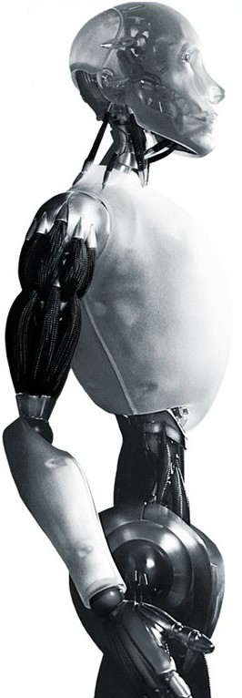
Robotics Kinematic Singularities
TU Berlin
Oliver Brock
TexPoint fonts used in EMF.
Read the TexPoint manual before you delete this box.: AAAAAAAAAAAAA

Slide 4
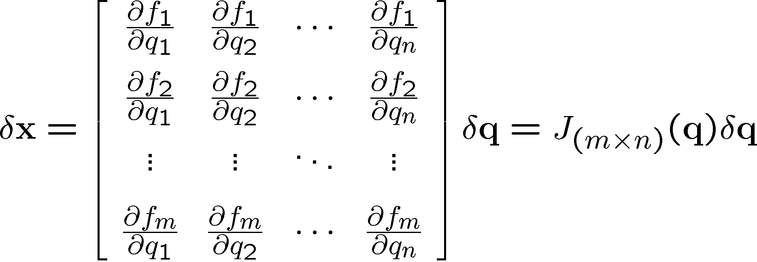
The Jacobian Matrix

Slide 5

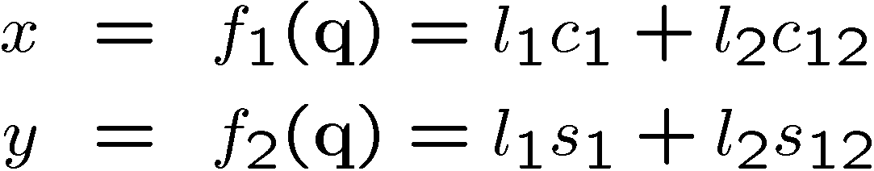


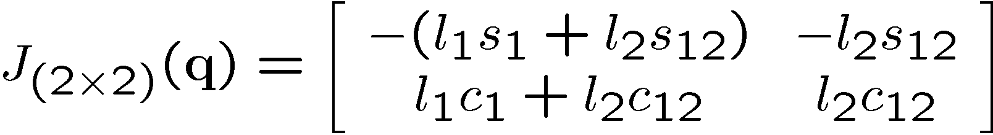
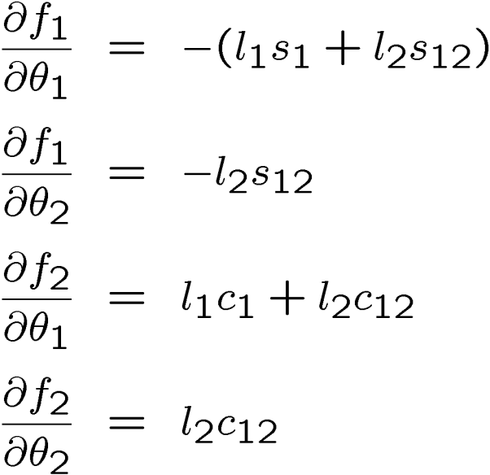
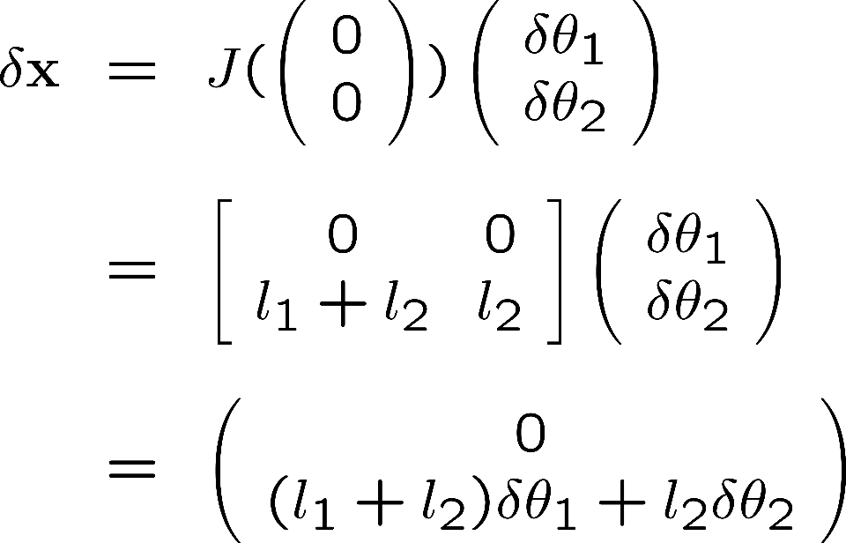
Jacobian: Example
Reminder:

Slide 6


Notes:
Illustrate what happens when a 2DOF rotational robot arm loses 1 DOF
Background image
https://www.pexels.com/photo/background-black-blackboard-board-159770/

Slide 7
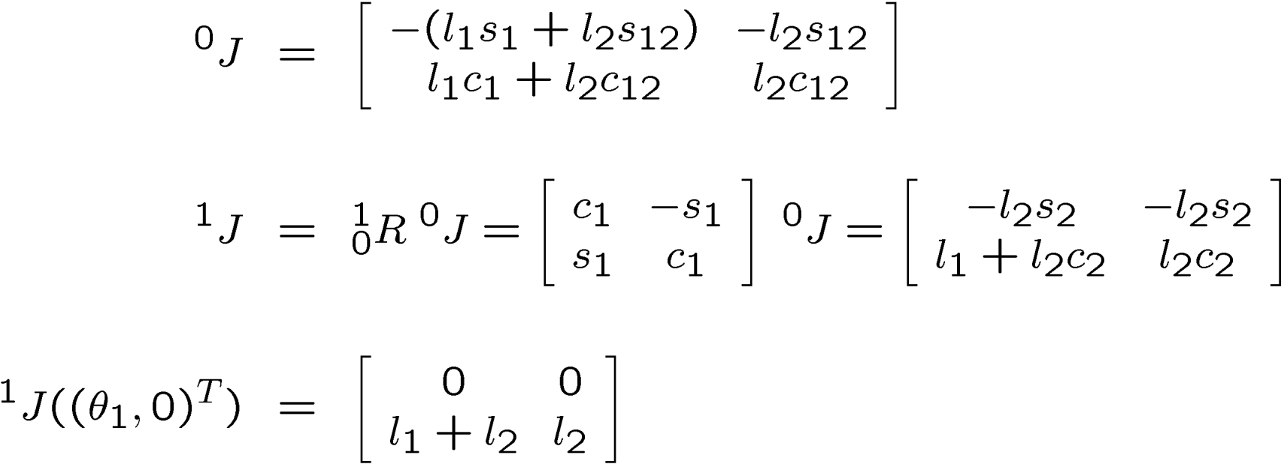
Kinematic Singularities
The determinant does
not change when the
reference frame changes
Notes:
Refresh your linear algebra: how can you compute a determinant? It is a great exam question to ask about the singularities of a robot…
http://en.wikipedia.org/wiki/Determinant

Slide 8
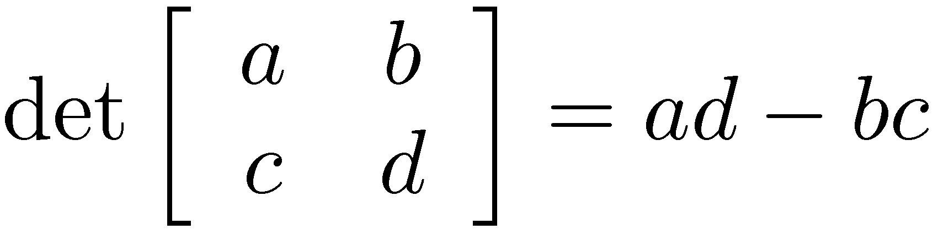
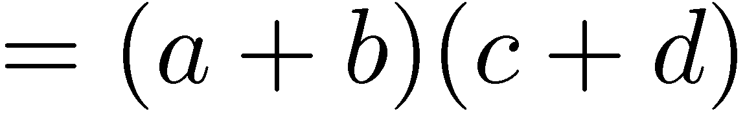
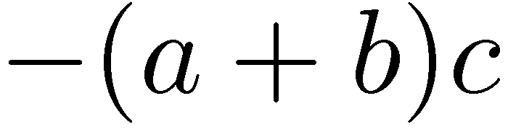
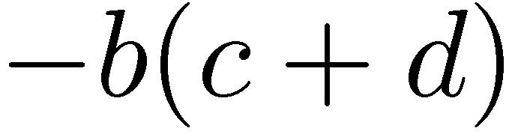
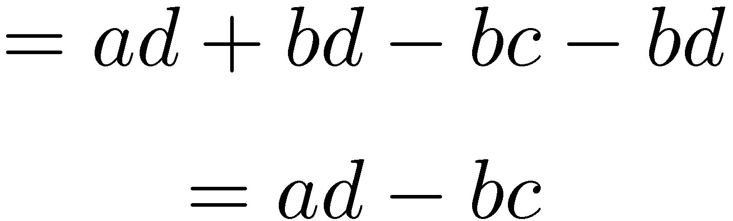
2D Determinant
c + d
d
c
b
a
a + b

Slide 9
Kinematic Singularities
If J loses rank, a singularity is encountered
The determinant for rectangular (non-square) matrices is not defined (almost not defined)
If J is rectangular (more columns than rows), the robot is redundant with respect to the task
Singularity can be detected by determining the determinant or eigenvalues and eigenvectors

